Slide 1

ServiceNow:
Multi-source eBonding
Driving cross-service supplier delivery operations from a single ticket
w/ Christopher

Slide 2
eBonding 101 - Foundation
Alpha Co.
Omega Inc.
ABC
123
eBonding is tying together system of records across solutions
A change in one record/ticket is reflected in another
Typically used in B2B services
Great for one-to-one integration
Note: eBonding is a two-way relationship between systems, not a dictation; i.e., an integration.

Slide 3
eBonding 201-401
201 - eBond standardization - scale and devops (crawl)
creating agnostic eBond framework for multiple source integrations
301 - eBond routing - intelligence (walk)
tickets flow to the right service provider based on ServiceNow CMDB & CSDM
401 - multi-source eBonding - cross service delivery (run)
tying together multiple source integrations to collaborate

Slide 4
eBonding vs. Integration
eBond is a bilateral fair communication relationship
typically, between separated ticketing solutions
B2B operations
integration is a unilateral communication dictation
typically, as-a-service (aaS) or pre-canned services
B2M procurement

Slide 5
Multi-source eBonding
Beta LLC.
Alpha Co.
Omega Inc.
XYZ
ABC
123
Delta Ltd.
DEF
Strategic initiative: Leverage multiple service providers across multiple service domains to insure best in market delivery
Tactical objective: Coordinate service operations across multiple service providers with overlapping service domains
Implementation solution: Leverage ServiceNow automation to create a multi-source eBonding framework to coordinate service delivery to insure the right service providers are engaged and coordinated through a central single ticket

Slide 6
Advantages
Right-size services by picking suppliers based on service domains
Enterprise is free to pick best-in-class and economical service operations across suppliers
Replace service suppliers where disruption is limited to select service domains
Remove captive suppliers
Coordinate broader service collaboration across service suppliers
Desegregate suppliers with overlapping service domains
Reduce finger-pointing
Reduce license consumption
Service providers can leverage their own ticketing solution

Slide 7
Challenges
Forces ServiceNow CMDB and CSDM maturity
Tickets are assigned based on CMDB CI, Service, and Service Offering
Tickets assigned to a supplier today, might be the wrong supplier tomorrow
Transitioning services between suppliers
When replacing a supplier the existing tickets need re-routed to the new supplier
Source of truth vs. warehouse of truth
Source of truth - The origin of facts
Warehouse of truth - The collation of one or more sources of truth to provide a broader view
Coordination of suppliers
How is information passed and transformed through ServiceNow across the tickets
How is the information represented across the tickets with different suppliers

Slide 8
Supplier Relationship
Push/Push Model (aka POST-POST)
limit REST API operations to POST w/ deltas
GET - prone to excessive use and resource pressures
PUT/PATCH - prone to insight failures and direct access security violations
DELETE - prone to insight failures and system of record violations
Fair Communications
each party set their incoming data payload standards
each party adheres their outgoing data payload to meet their supplier incoming data payload standard
changes to one party does not incur a change on another

Slide 9
Scenario
Beta LLC.
Alpha Co.
Omega Inc.
XYZ
ABC
123
Delta Ltd.
DEF
Omega Inc. has adopted a multi-supplier strategy across various services to provide best in class support for the enterprise. Alpha Co. provides call center support. Beta LLC. provides data recovery services. Delta Ltd. provides server administration.
A call comes in to Alpha Co. reporting a server is unreachable and an incident ticket is created.
The ticket is eBonded to Omega Inc. The server record in the CMDB is linked to Delta Ltd. for support. A business rule auto-assigns the ticket to Delta Ltd. which eBonds to Delta Ltd. creating a new ticket on Delta Ltd. ticketing system.
Delta Ltd. determines it needs a full system restore and changes the ticket service offering to Server Restoration. That service offering is supported by Beta LLC.
A business rule triggers based on change to the service offering to eBond the Omega Inc. ticket to now include Beta LLC.
As Beta LLC. works their ticket, the information is passed to Omega Inc. which proxies updates to Alpha Co., and Beta LLC tickets.

Slide 10
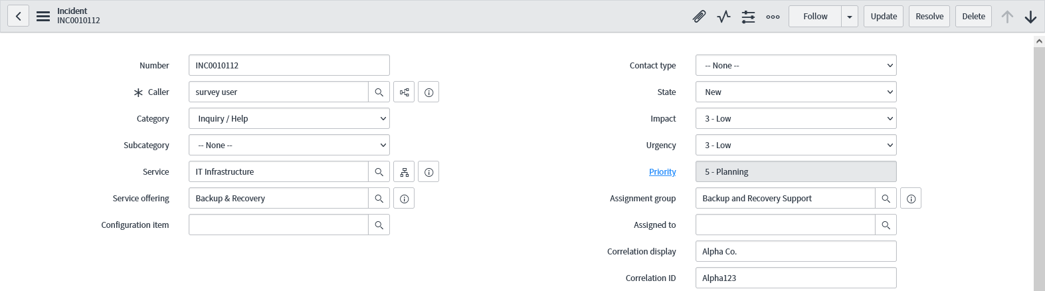
OOTB from ServiceNow

Slide 11
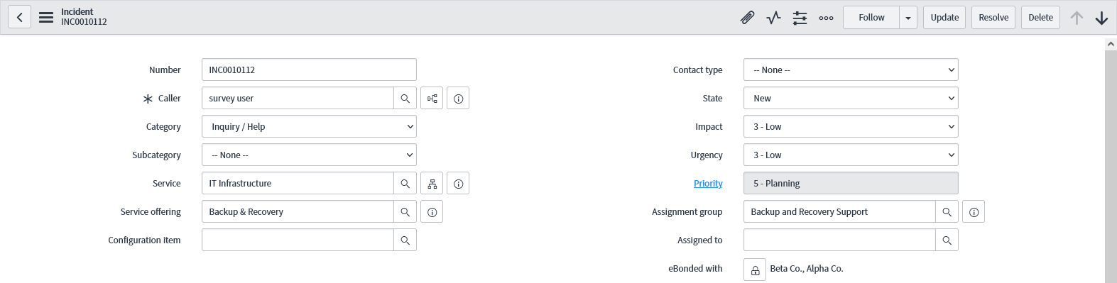
Custom Enhancements

Slide 12
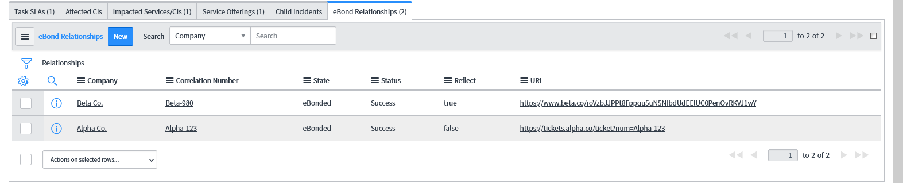
Custom Enhancements (cont.)

Slide 13
ServiceNow Components
Single import set staging table per target table w/ transform
data map table (trust, but verify)
registry table (security and misc.)
Relationship table
one to many; links single record to multiple suppliers
denote other special relationship characteristics per ticket per supplier
Payload table
async operations
automatic recovery & true-up

Slide 14
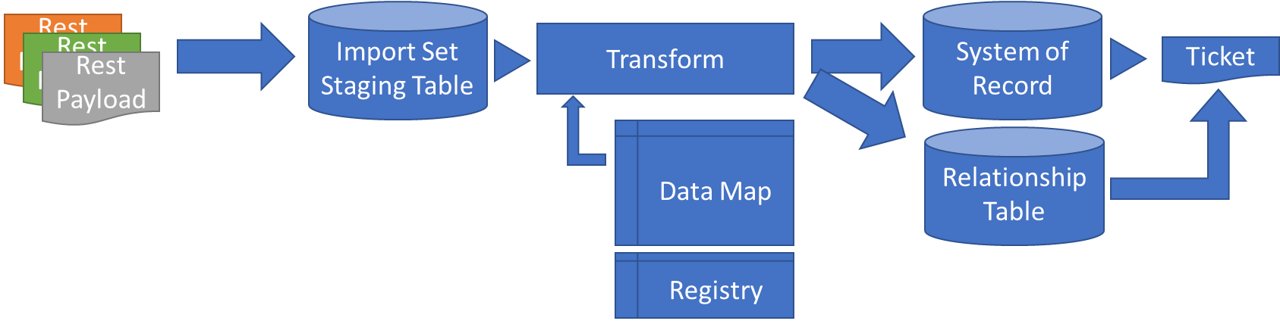
Inbound Diagram

Slide 15
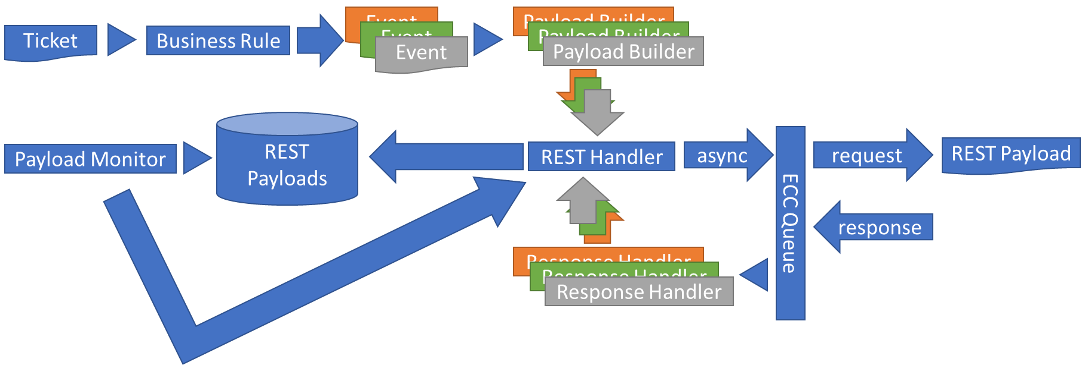

Outbound Diagram
There is some development needed per supplier

